Slide 1

Virtual Fitting Room
Virtual Fitting Room
Principles of Software Architecture

Slide 2

Presented by: Shrouk Ali 18107904 Yousra Salah 18107956 Mazen Emad 18107837 Ahmad Fadel 17107784 Omar Hossam 18107282
Supervised by: Dr. Diana Mosa
Eng. Manar Hafez
Virtual Fitting Room

Slide 3
i) Proposal ii) Business Case iii) Requirement Analysis iv) Risks v) Software Architecture Levels vi) Kruchten’s 4+1 vii) Architecture Styles viii) UML diagrams ix) Conclusion
Content
Virtual Fitting Room

Slide 4
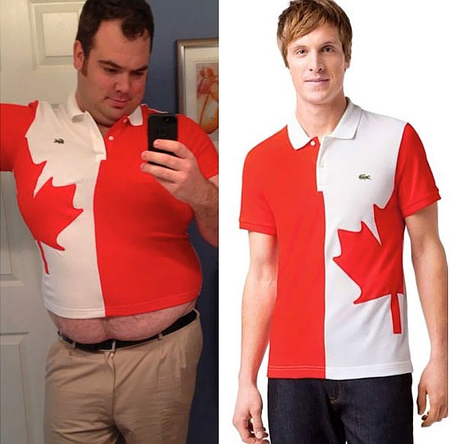
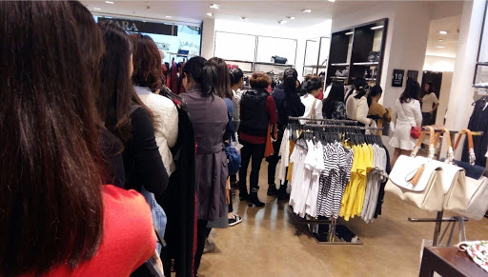
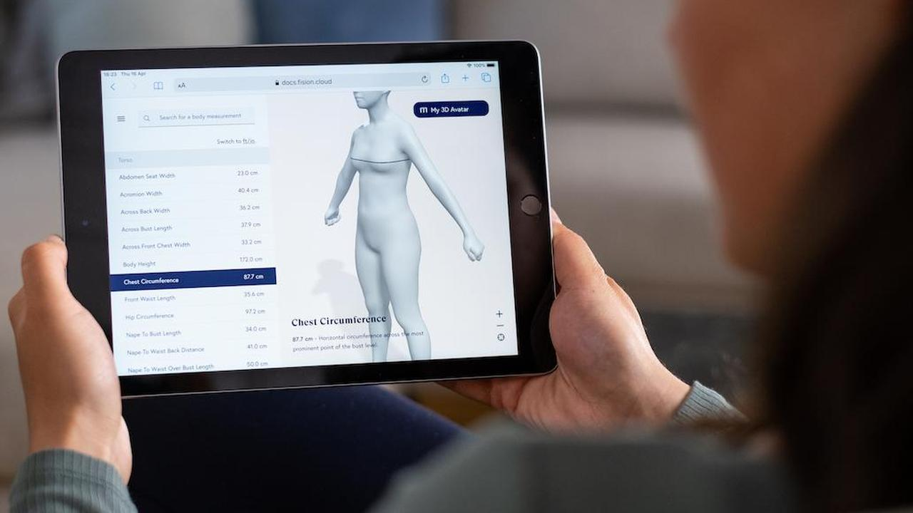
Proposal
VFR
Project Name
Virtual Fitting Room
Problem definition
A survey has been done reveals consumer’s fear of buying the wrong size and hassle of returns
as a top reason why people hesitate of buying online. Also, Due to the current pandemic people
are afraid to try clothes or shop from malls.
Solution
As finding your expected item is totally doable using our system, our main aim is removing the
consumer’s obstacles while shopping online. Virtual fitting room is complementary tool for small
and large retailers. It is a unique system which allows users to combine up their body measurements
and generates a 3D model avatar for them. Helping them to shop online easily.
Recommendation
-You should make sure of your measurements while creating your 3D model
-Make sure to order the same recommended size for you
Signature
Shrouk Ali Yousra Salah Mazen Emad Omar Hossam Ahmed Fadel

Slide 5
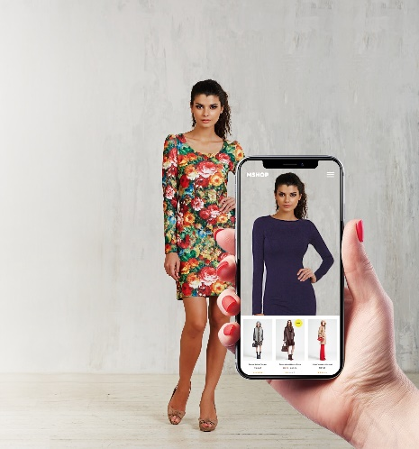
Business Case
VFR
Reasons
-Virtual fitting rooms offer an engaging and personalized experience for online shoppers, allowing them to pick out and purchase outfits when it is most convenient for them and without the hassle of trying clothes on in a store.
-Due to the contagious diseases such as covid-19 people no longer go to the store so all the sales for all stores have been decrementing.
-Keeping the clothes hygiene enough after being tried is hard to keep track on.
Benefits
-The virtual dressing room can potentially reduce the number of returns from online consumer
-Increases the sales of the shop
- The Convenience
Most people lead busy lives, and when they need to buy something, they will usually opt for doing it over the internet so adding this feature to online shoppers, instead of going to a physical store. It saves them time, effort, and even money.
Timescales
Initial analysis shows that the system will take approximately 4-5 months to implement.
Risks
-Right now, the project looks straightforward but there are still some unknowns surrounding implementation. There is also the risk that the project does not meet the sales team or consumers needs. For this reason, it is essential to involve the sales team closely.
Options considered:
-Adding a dedicated project management team
-Adding additional staff for website development
Cost
Virtual fitting room software: $35,000 & Project management = $30,000
& Software team of 5 for 4 or 5 month = $90,000
Total estimated cost = $155,000

Slide 6
Requirement Analysis is critical to the success or failure of our software system
VFR
Functional Requirements
Non-Functional Requirements
Requirement
Analysis:
Registration Login
Logout Save Information
Get your size Customize your avatar
Purchase premium avatar Change requirements “filter”
Reserve Item Show All items
Display Pictures Provide feedback
Mark as like Notify me
Security Portability
Availability Accessibility
Localization
Usability
Learnability Efficiency
Memorability Errors
Satisfaction

Slide 7



Factors that affect the design of software architecture of our system
VFR
Stakeholders
“Top priority”
Risks
“minimize risks”
Schedule
“priorities”
Scale
“Project Size”
Skills & development
“team expertise”
Materials & Costs

Slide 8
Software Architecture Levels
VFR
Solutions Architecture
Layer 2&3
Business Architecture
Layer 1
Technical Architecture
Layer 2&3
Updated expert in Web Development
User Experience expert
Web administrator
Testing expert
Backend team
Database management team
Project manager
3D max expert
Advantages:
-As a website makes you look professional
-Your website can attract new customers through Google
-You can clearly showcase your products and services
-You can integrate your website with Google Maps so people can find you more easily
needed technologies:
WordPress
HTML/CSS/JavaScript/CSS framework
Responsive Web Design
Programming language
3D max
Testing
Backend
Project management
Database
Our main aim is removing the consumer’s obstacles while shopping online. Virtual fitting room is complementary tool for small and large retailers. It is a unique system which allows users to combine up their body measurements and generates a 3D model avatar for them. Helping them to shop online easily. Avoid to retouch the items again from the store thus avoiding contagious diseases

Slide 9
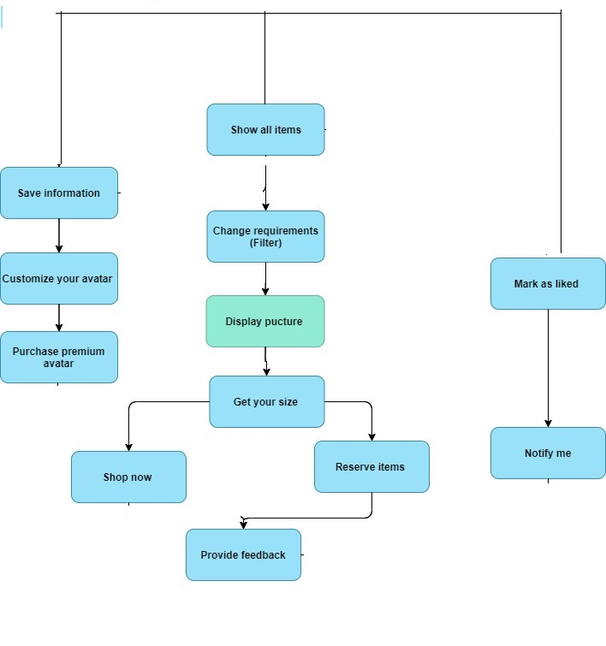

Enterprise Architecture
VFR
Layer 2

Slide 10

Product Line Architecture
Input | Process | Output
User’s information | Registration | Account made
The account registered with | Login | The brand’s page
 | Logout | Login page
More details about the user | Save information: | Recommended items
Measurements of the user | Get your size: | Suitable size for the item
Measurements of the user | Customize your avatar: | Generated avatar
Measurements of the user and more specified info and the credit card | Purchase premium avatar: | A more realistic Avatar
User requirements regarding the items | Change requirements (Filter): | Filtered items
Details of the order and credit card info | Shop now: | Save the information
Details of the order | Reserve Item | Save the information and request reservation
Home page | Show all items: | List of available items
Item | Display pictures: | Item’s picture
Details of the item | Provide feedback: | Save the information
Details of the item | Mark as like: | Save the information
Saved information | Notify me: | Restocked items according to the likes and profile
VFR
Layer 1

Slide 11
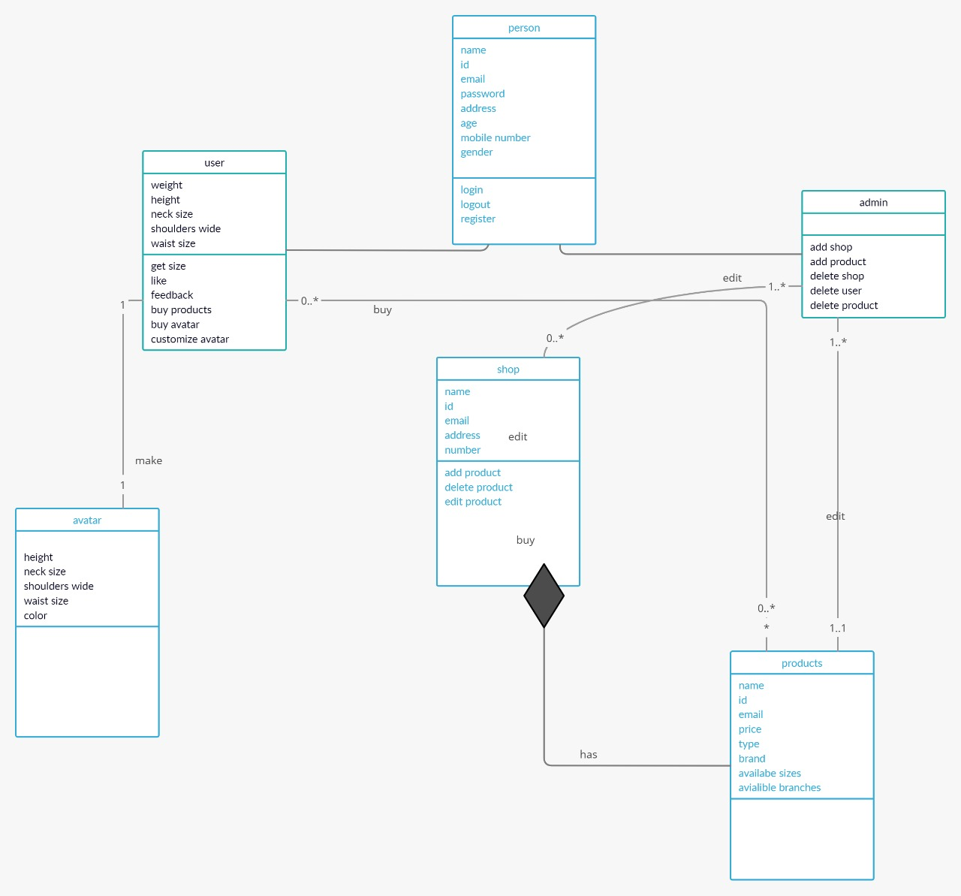
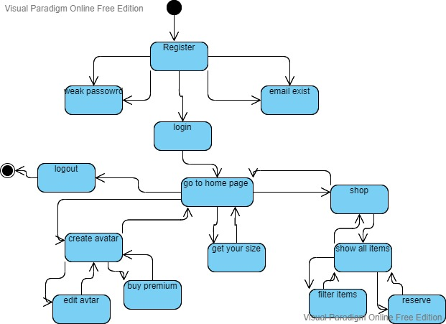
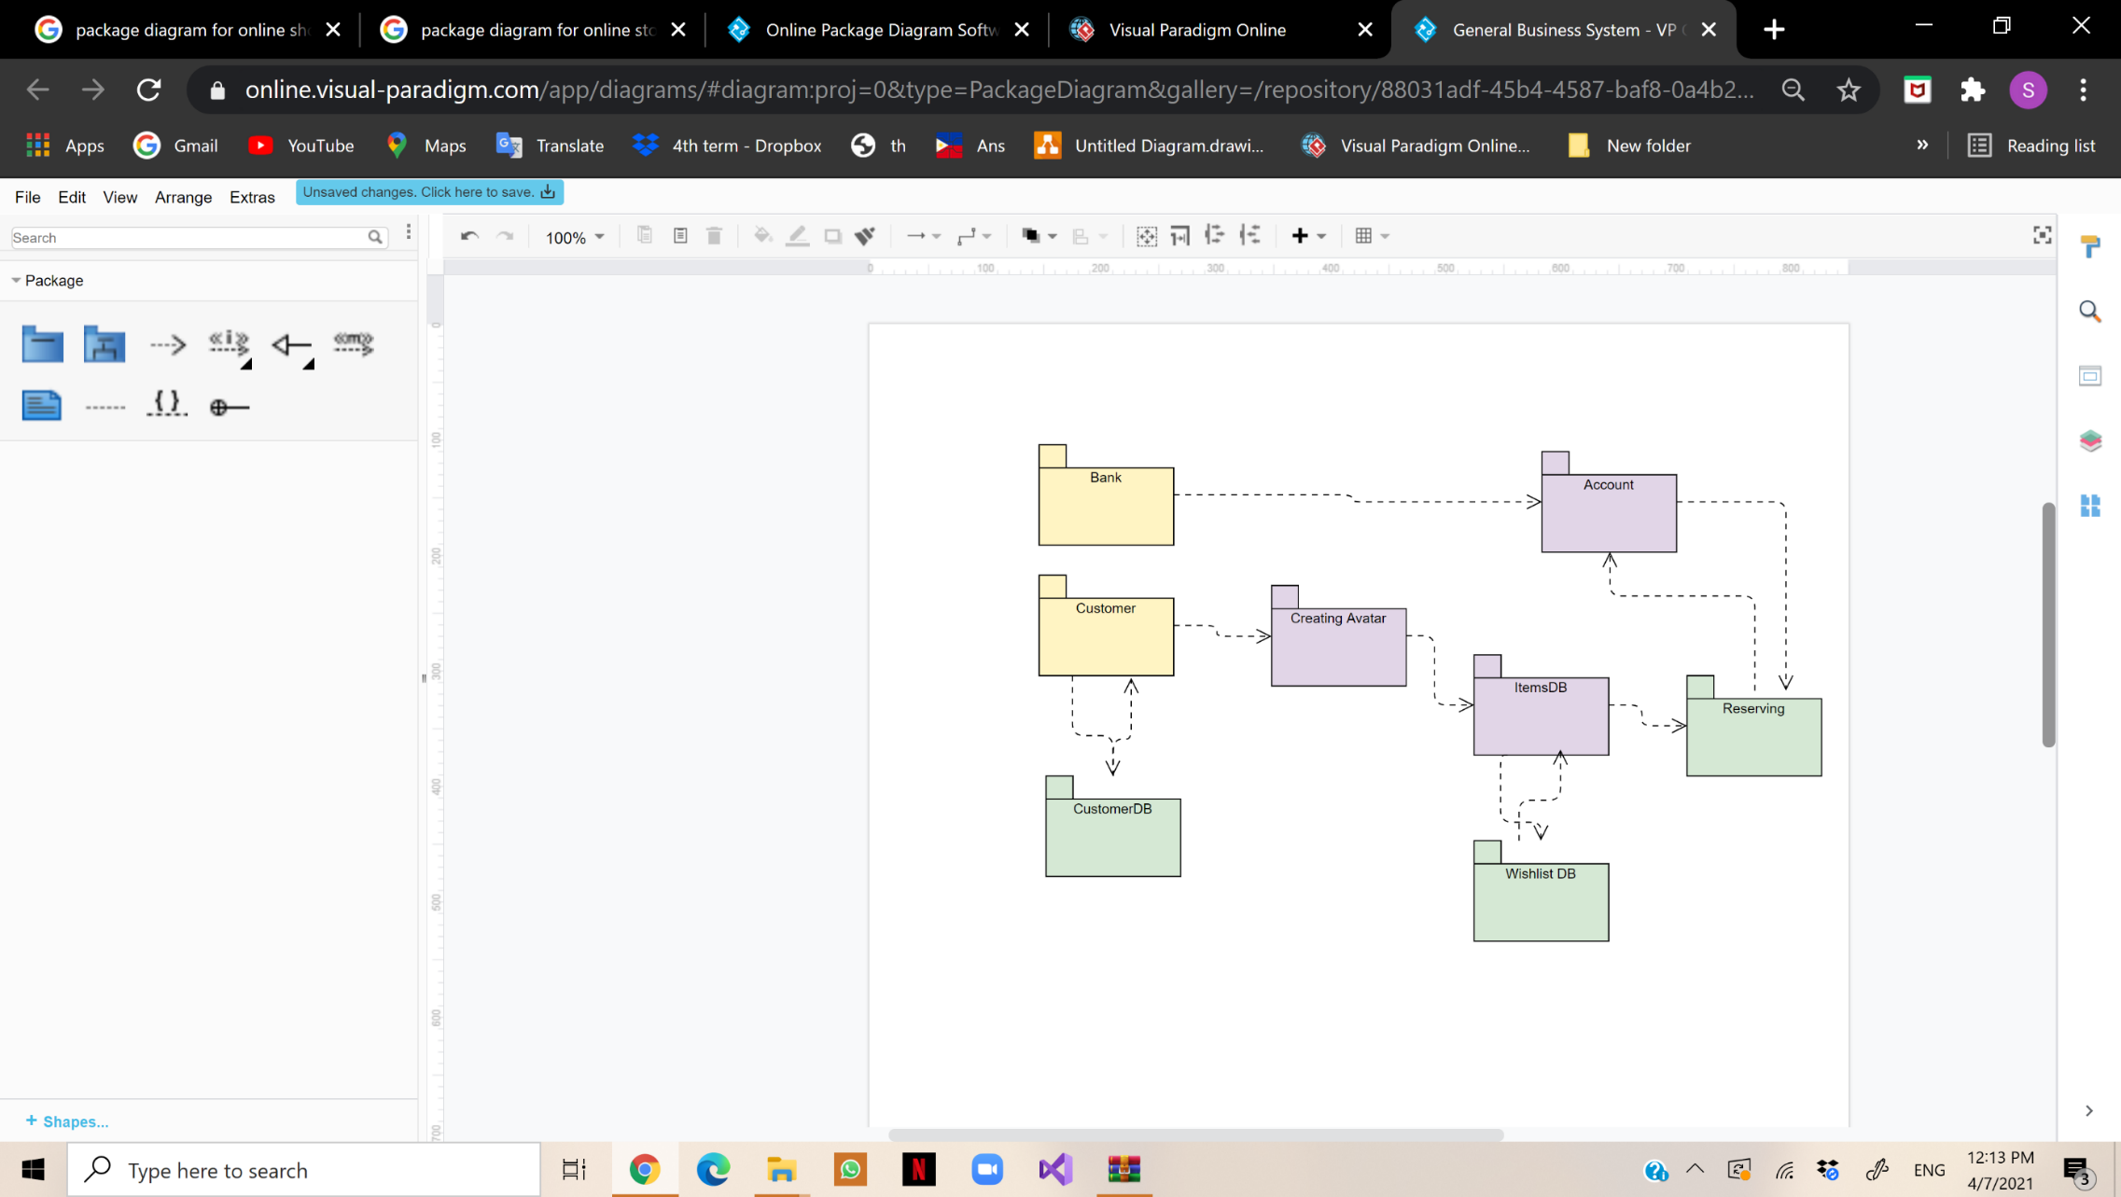
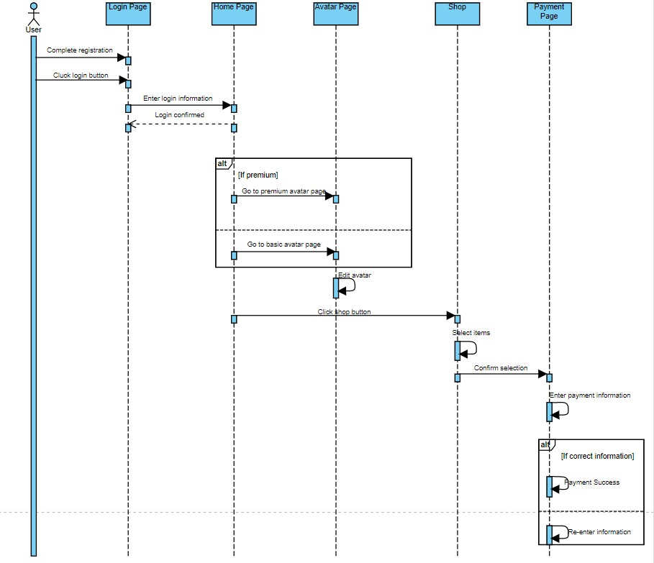
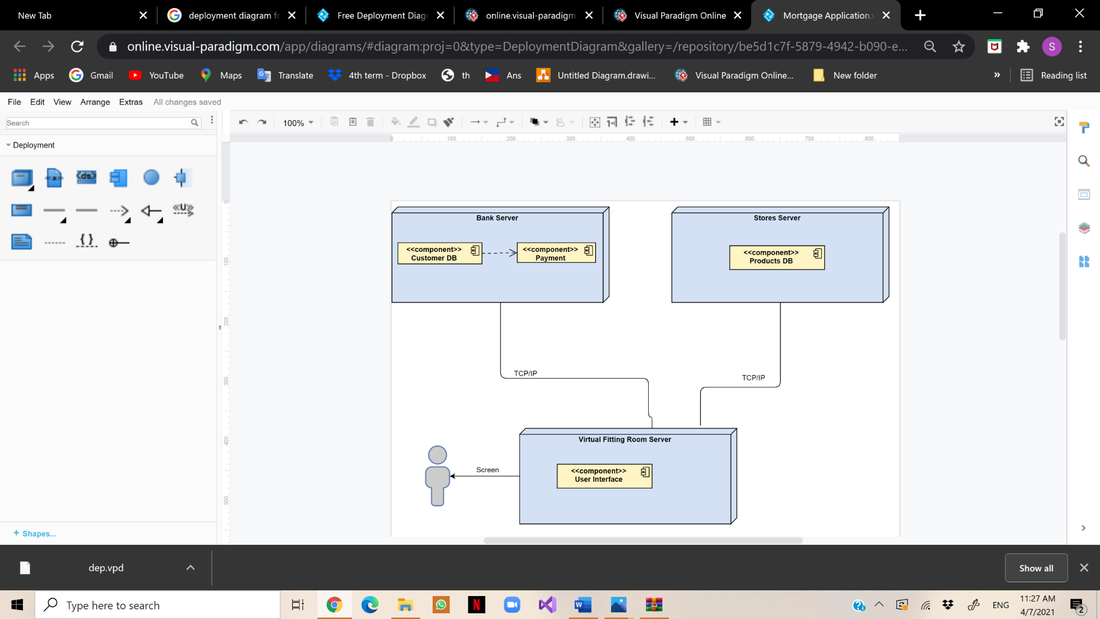
Architecture Views (Kruchten’s 4+1)
VFR
Conceptual
Physical
Logical View
Implementation View
Class diagram
State diagram
Package diagram
Use case diagram
Sequence diagram
Deployment diagram
Process View
Deployment View

Slide 12
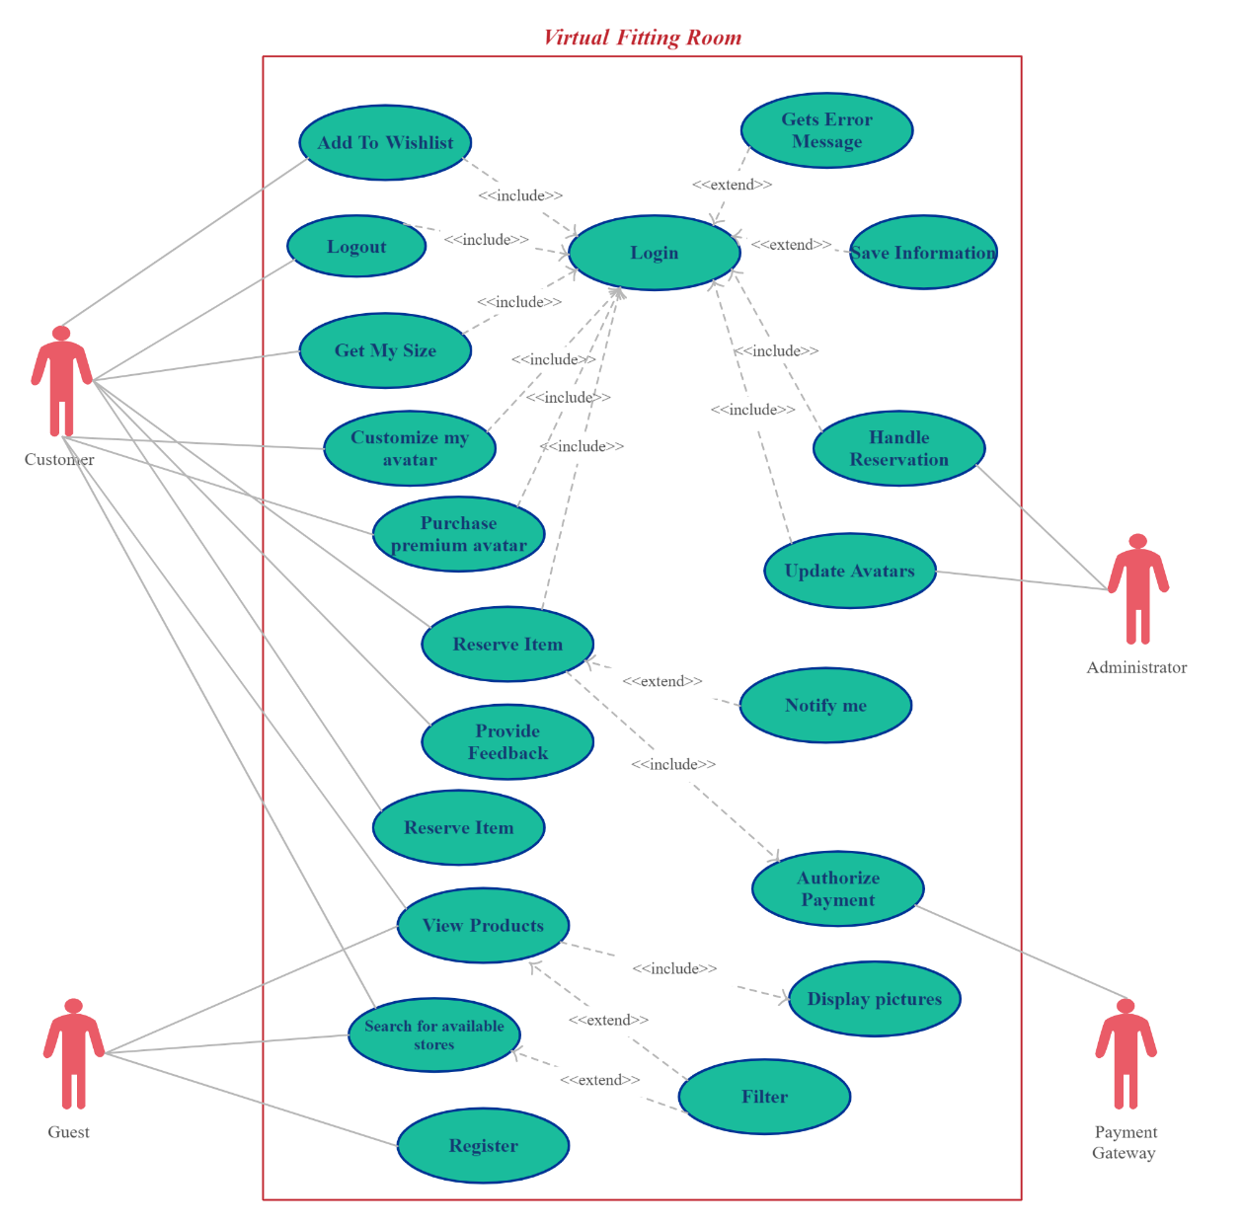

Use case diagram
VFR

Slide 13
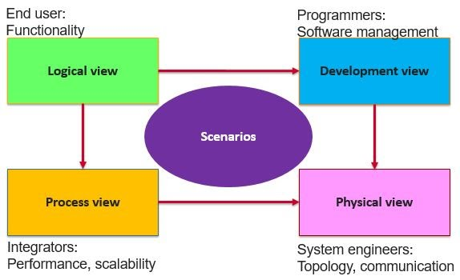
Logical View: State diagram
VFR

Slide 14
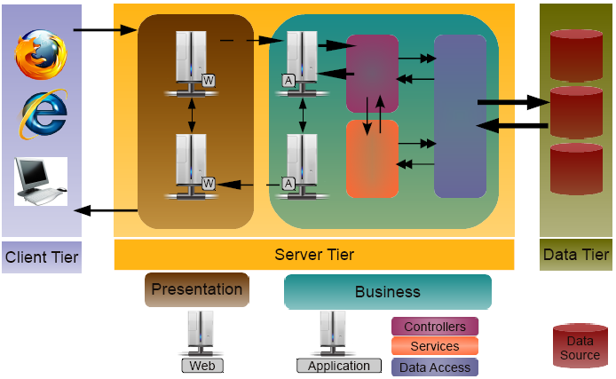
Architecture Styles
VFR
Architecture Patterns
“Putting It All Together” architectural style is the most suitable one.
The layered architectural pattern is applied in the project due to it being a desktop application that can be divided into separate tasks where each layer provides a service to a higher layer. The layers will be divided into: -
Presentation layer
Application layer
Business logic layer
Data access layer

Slide 15
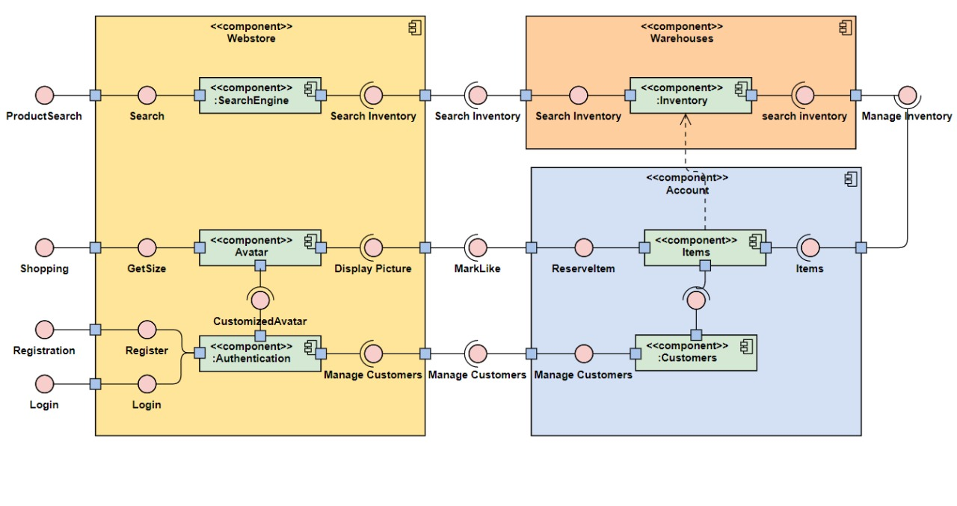
Structural diagrams: Component diagram
VFR

Slide 16
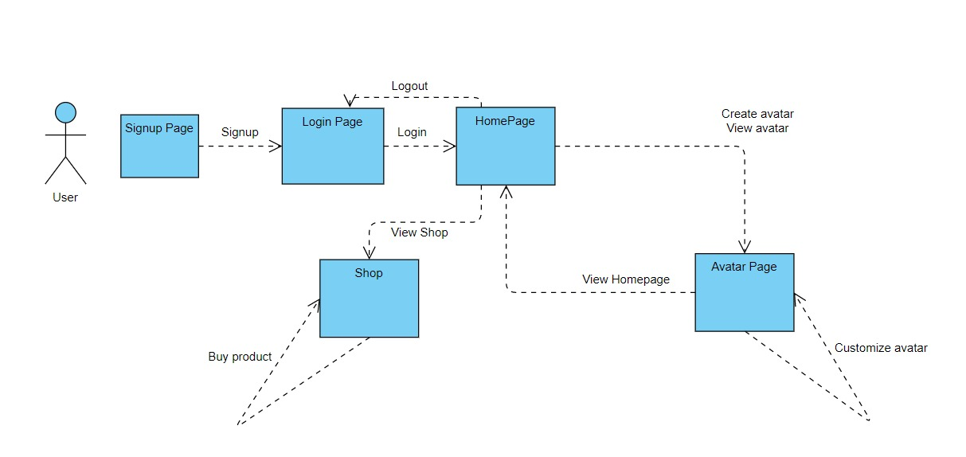
Structural diagrams: Communication diagram
VFR

Slide 17
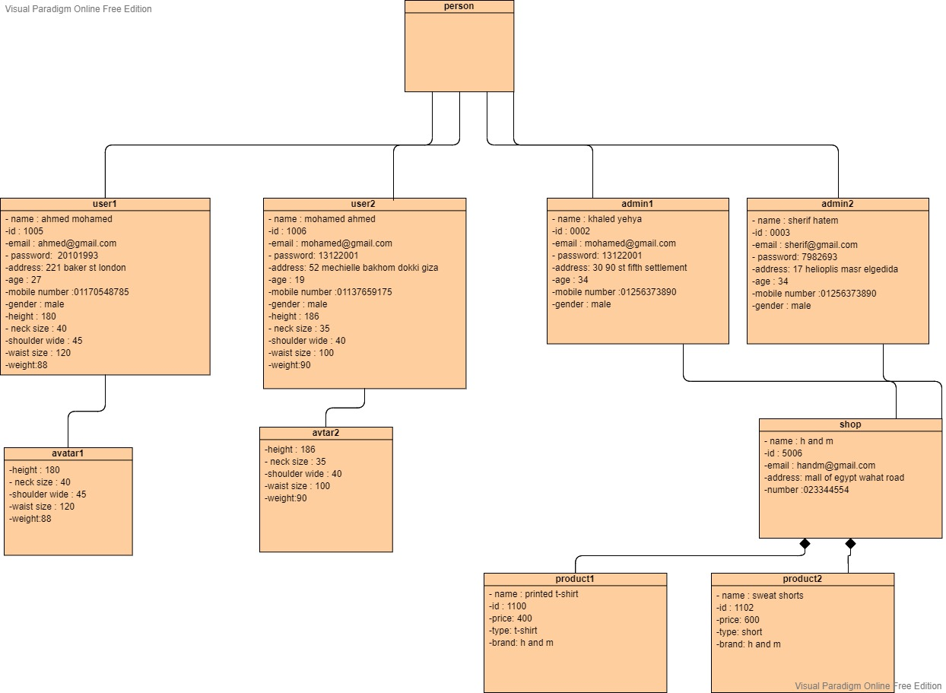
Structural diagrams: Object diagram
VFR

Slide 18
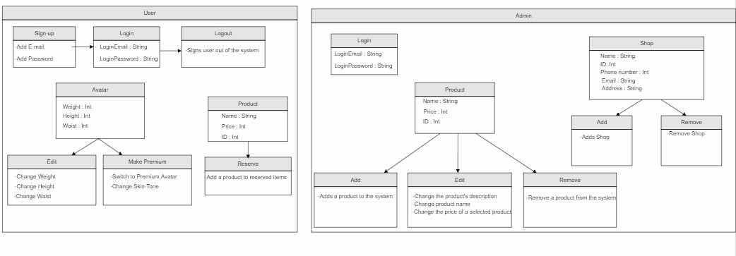
Structural diagrams: Profile diagram
VFR

Slide 19
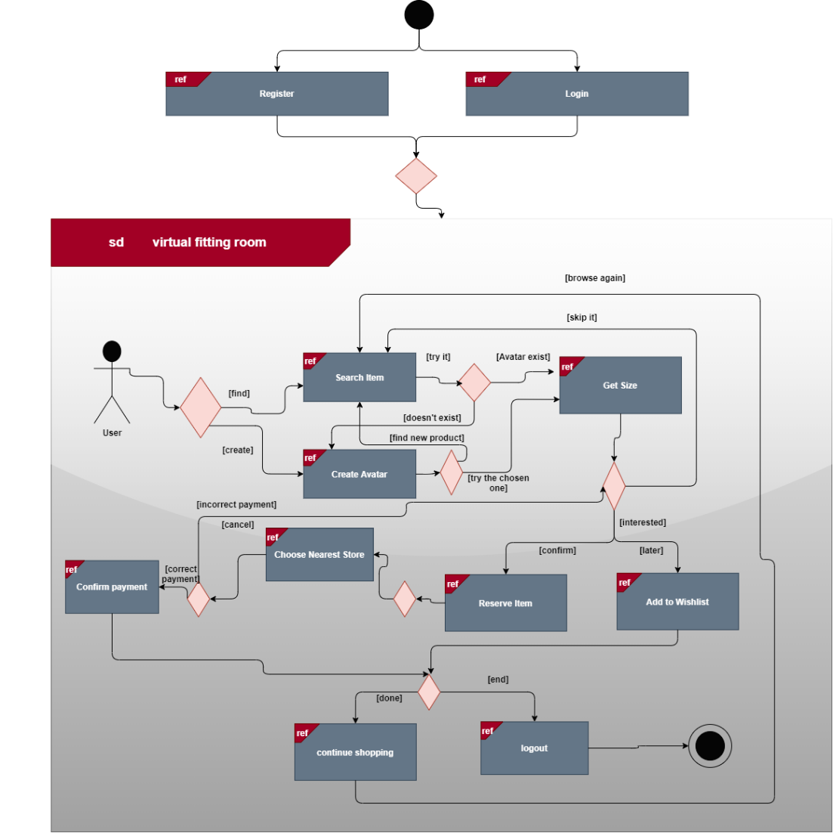
Behavioral diagrams: Interaction Overview diagram
VFR

Slide 20
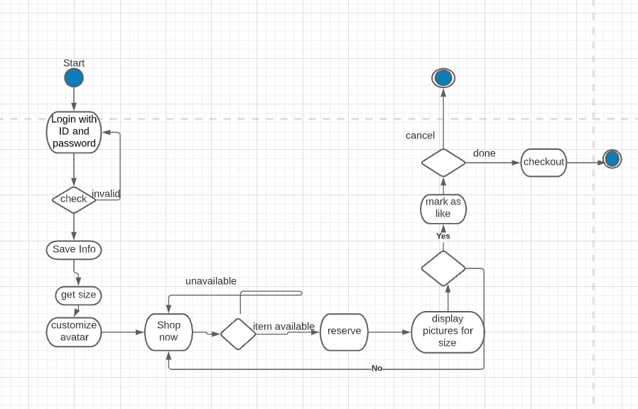
Behavioral diagrams: Activity diagram
VFR

Slide 21
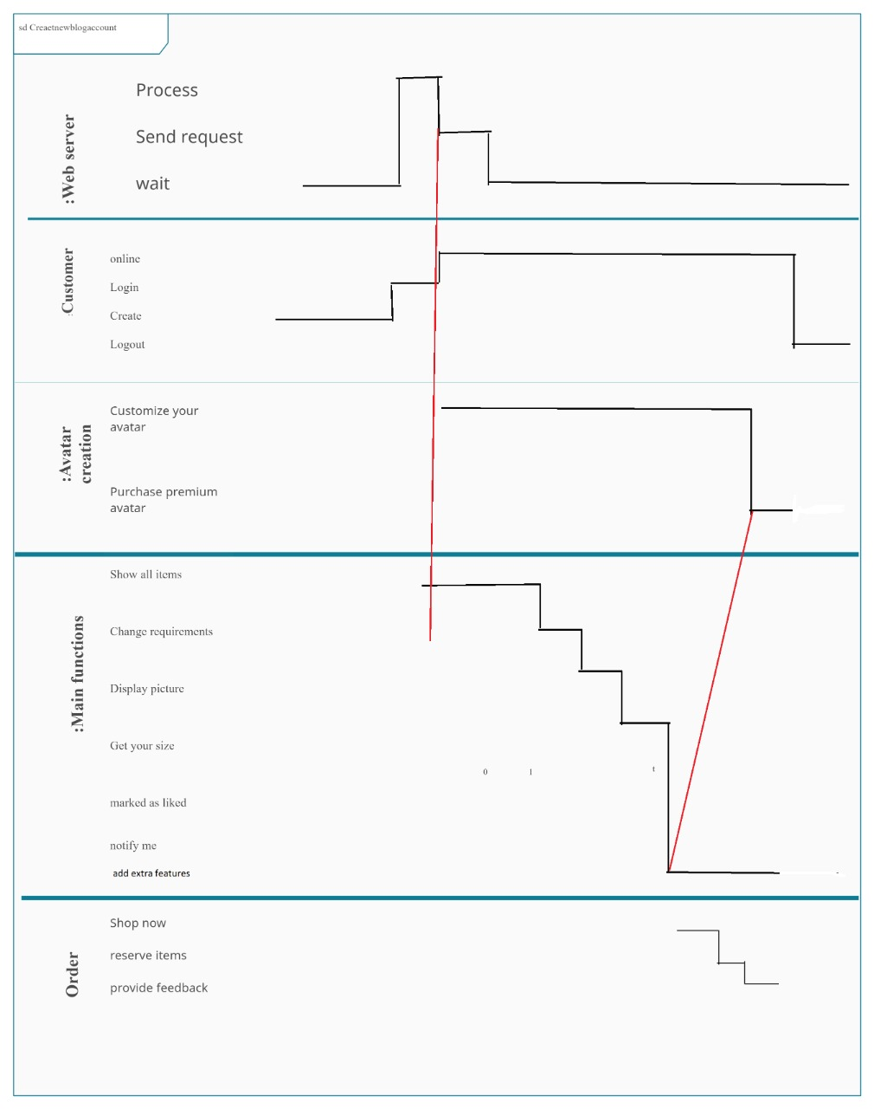
Behavioral diagrams: Timing diagram
VFR

Slide 22
Conclusion
VFR
Finding your expected item is totally doable using our system.
The recent technology innovations helped us to eliminate our fears of online shopping like buying wrong sizes and hassle of returns.
planning software architecture well helps us to make sure that the database is secure enough and away from client by dividing the system into three tiers to isolate the database. In addition to adding firewall to protect it against any attacks. As bas architecture means bad security.
Planning a good architecture is mandatory to enable stakeholder to communicate and analyzing the system before coding to avoid wasting money.
Making manifest and checking every step to keep track with all the updates
Using Documents to remember and share design decisions among the team

Slide 23
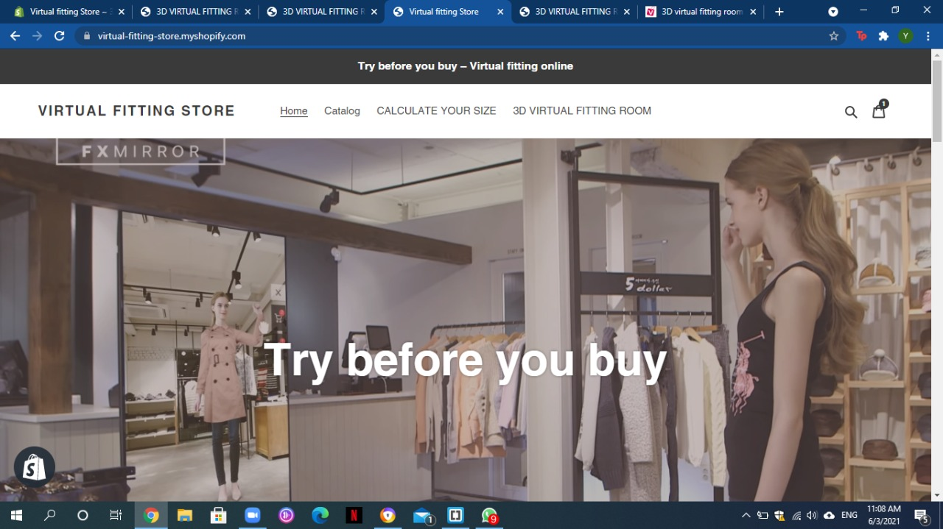
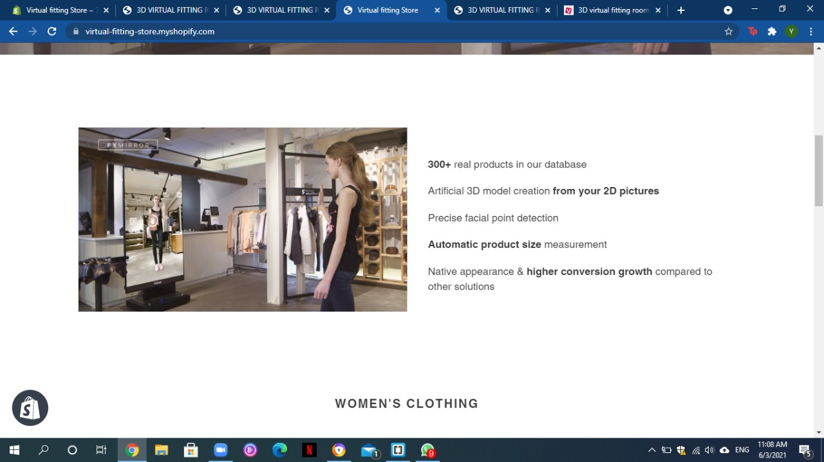
Implementation

Slide 24
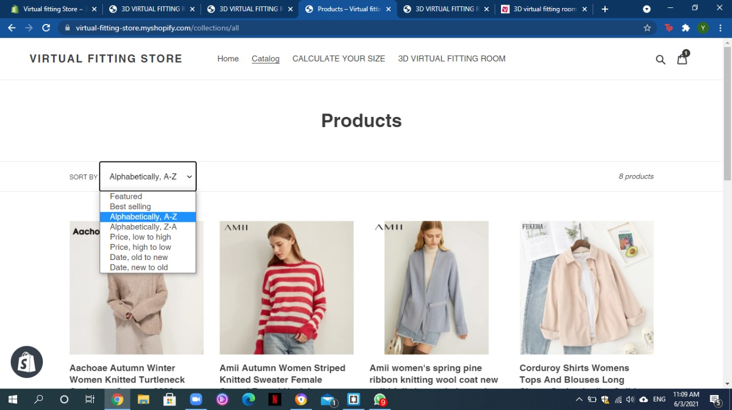
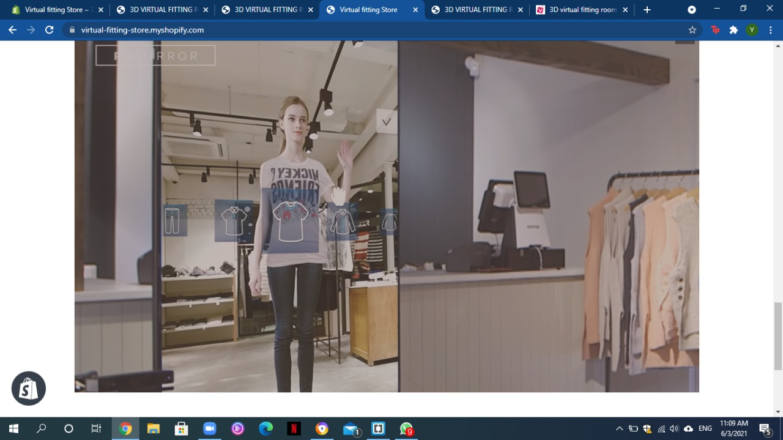
Implementation

Slide 25
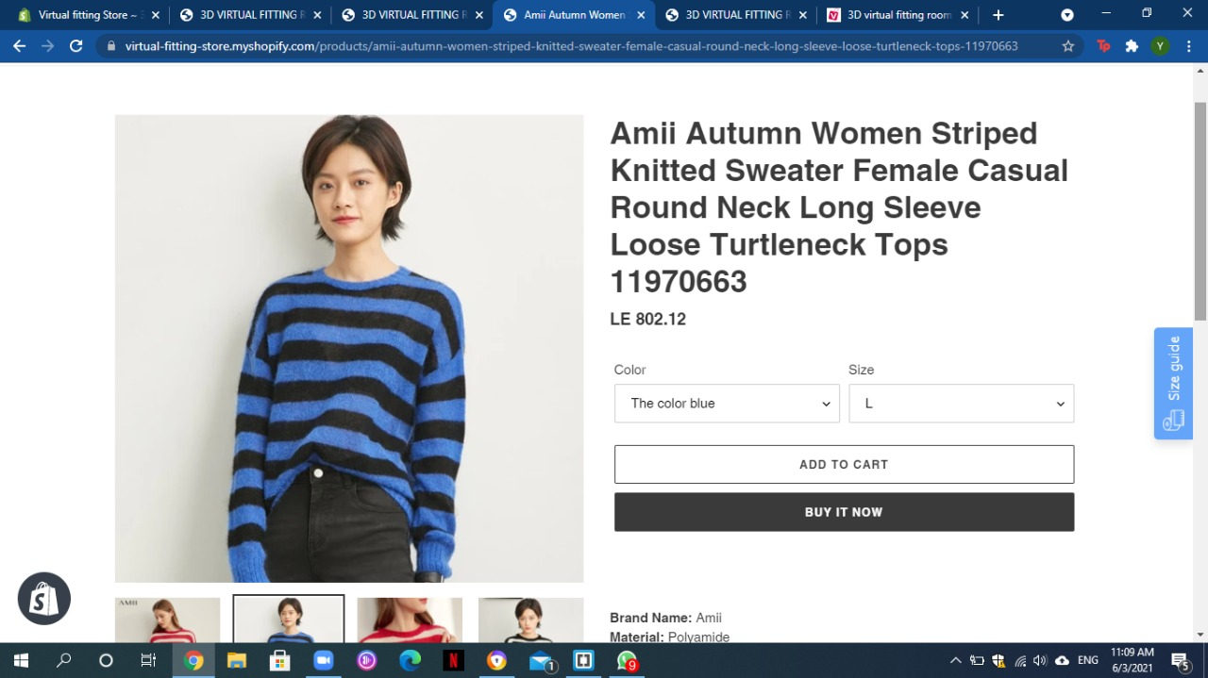
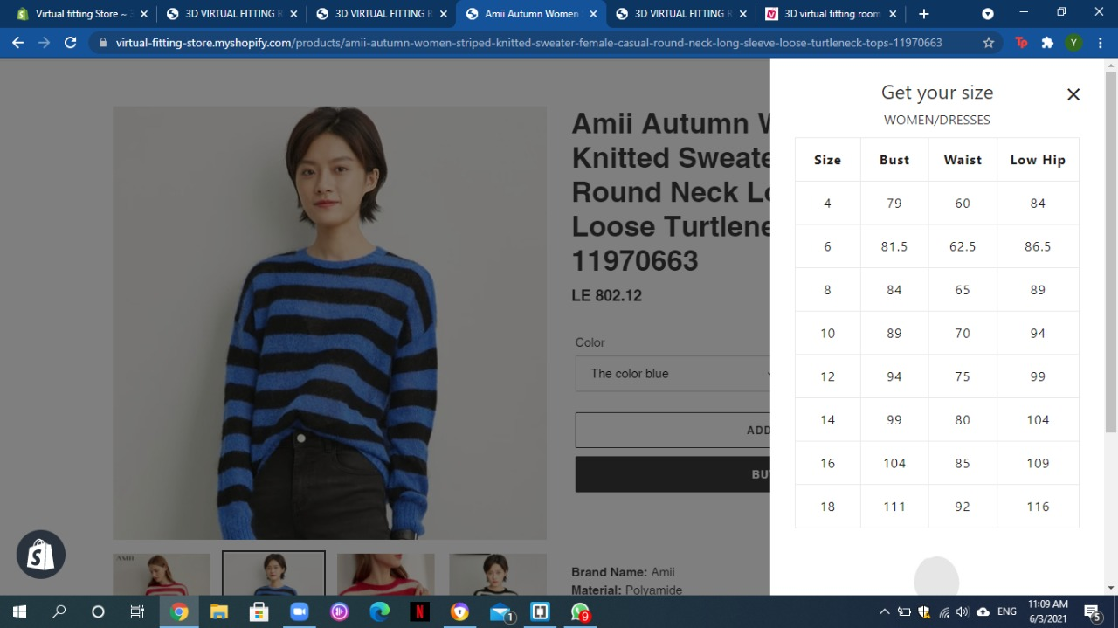
Implementation

Slide 26
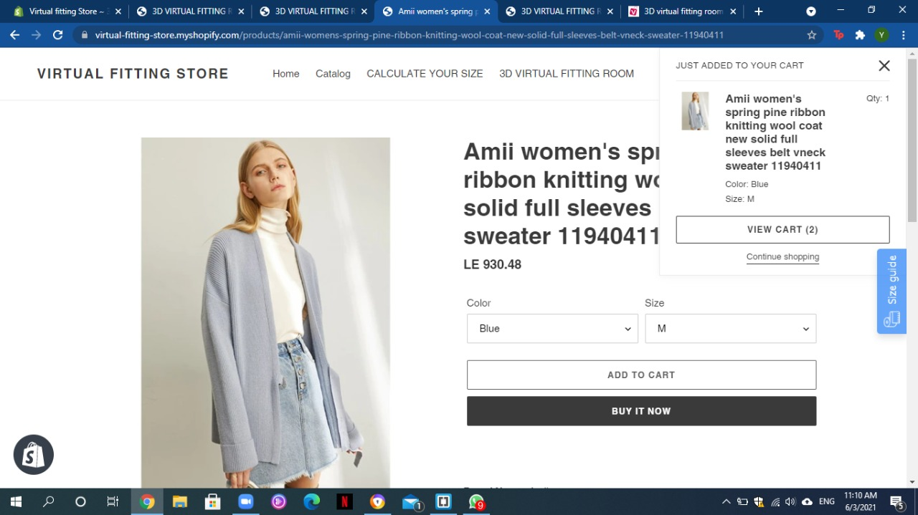
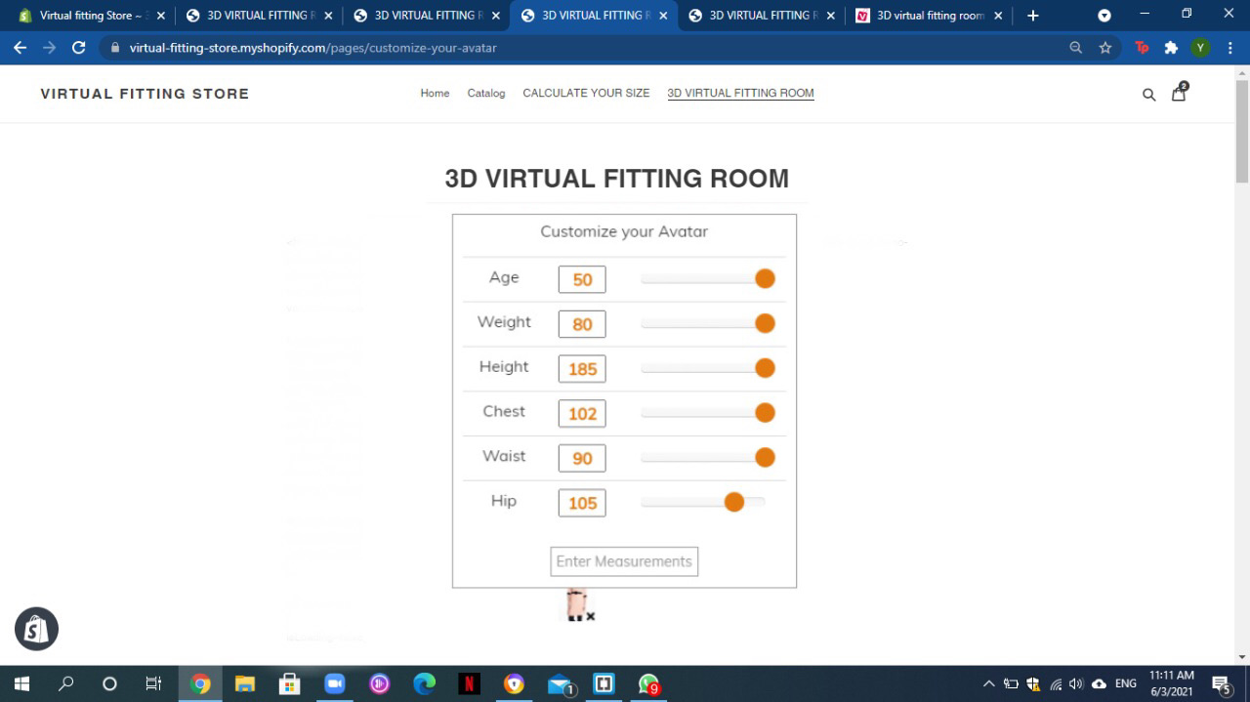
Implementation

Slide 27
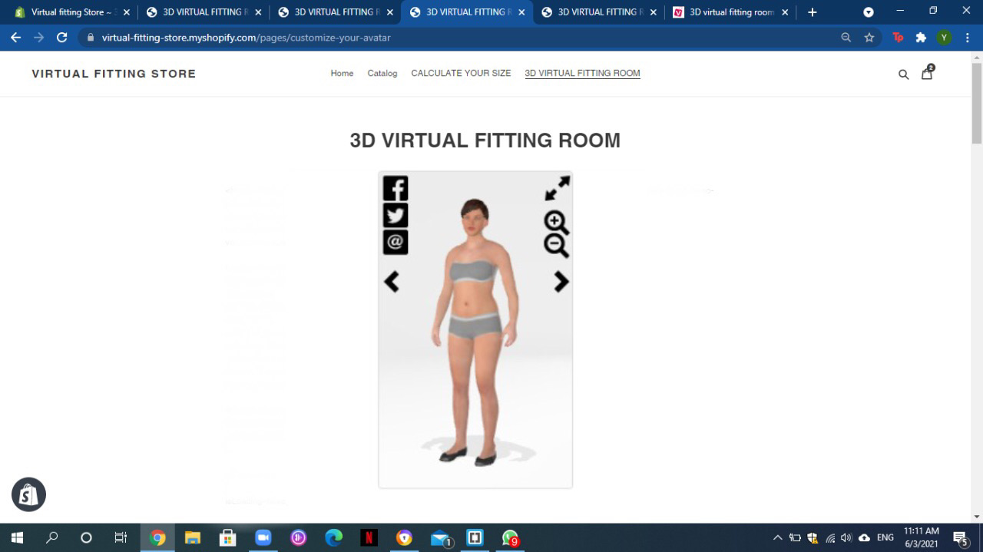
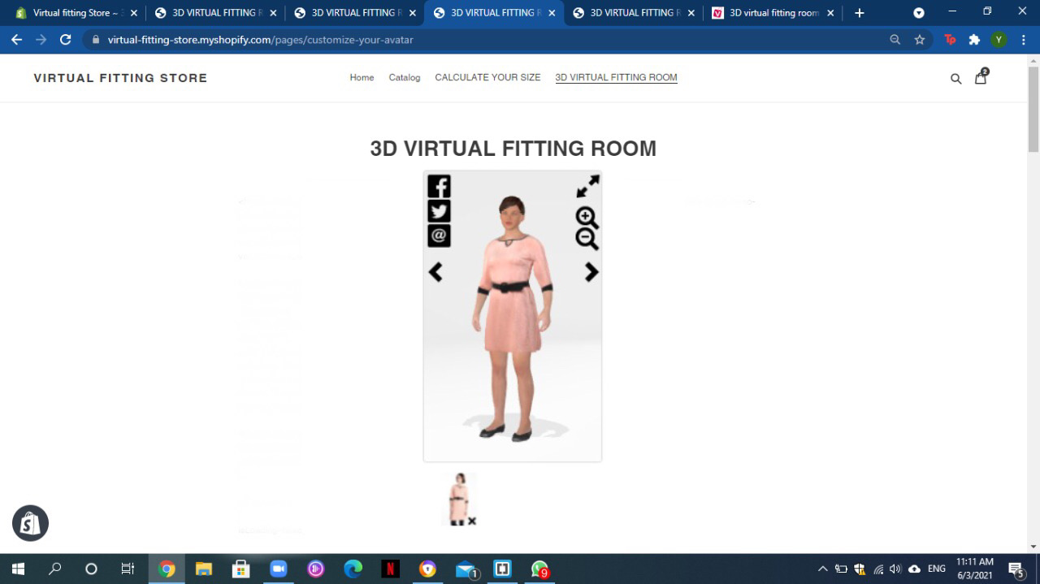
Implementation

Slide 28
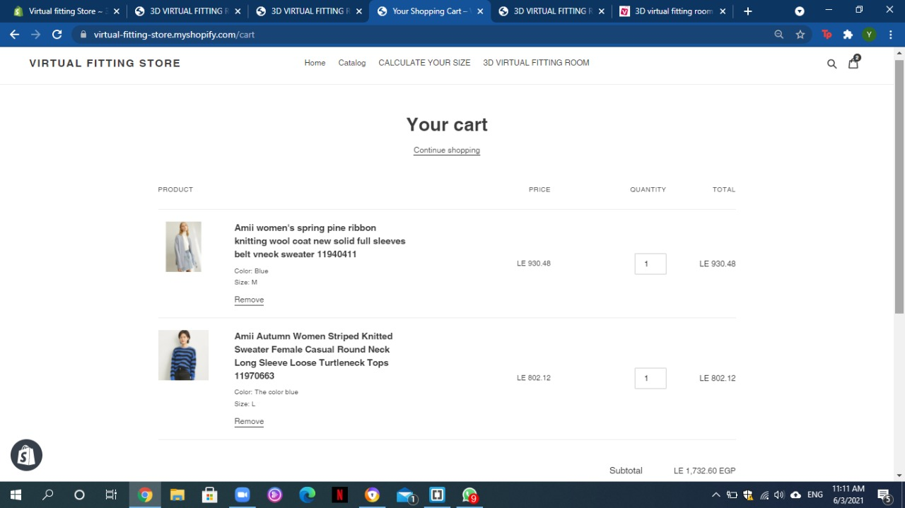
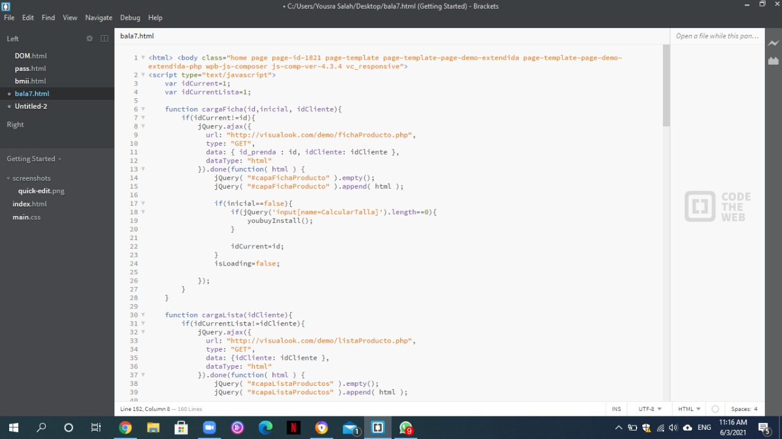
Implementation

Slide 29
Thank you!
Virtual Fitting Room

